Slide 1
Challenge and Change Q&A
Rochell Rowe,
Youth Led Change Program Lead

Slide 2
Our mission
To bring lasting change to the lives of young people; investing in them as powerful forces for change and acting upon their right to be heard in pursuit of a fair and just society.

Slide 3
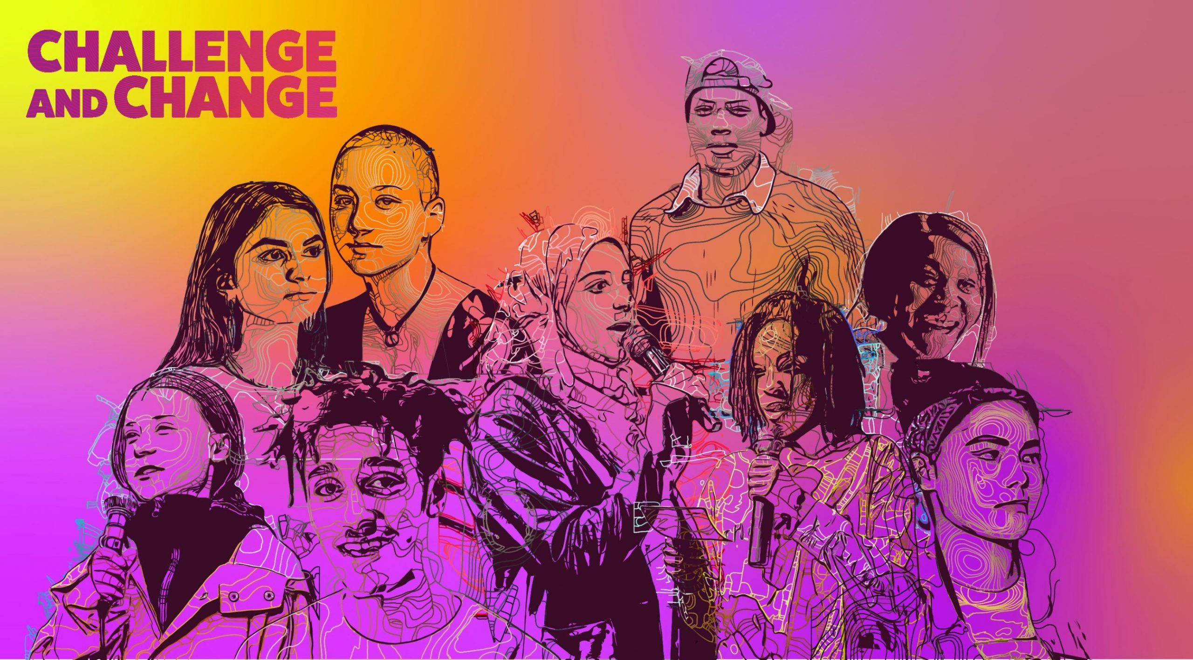

Slide 4
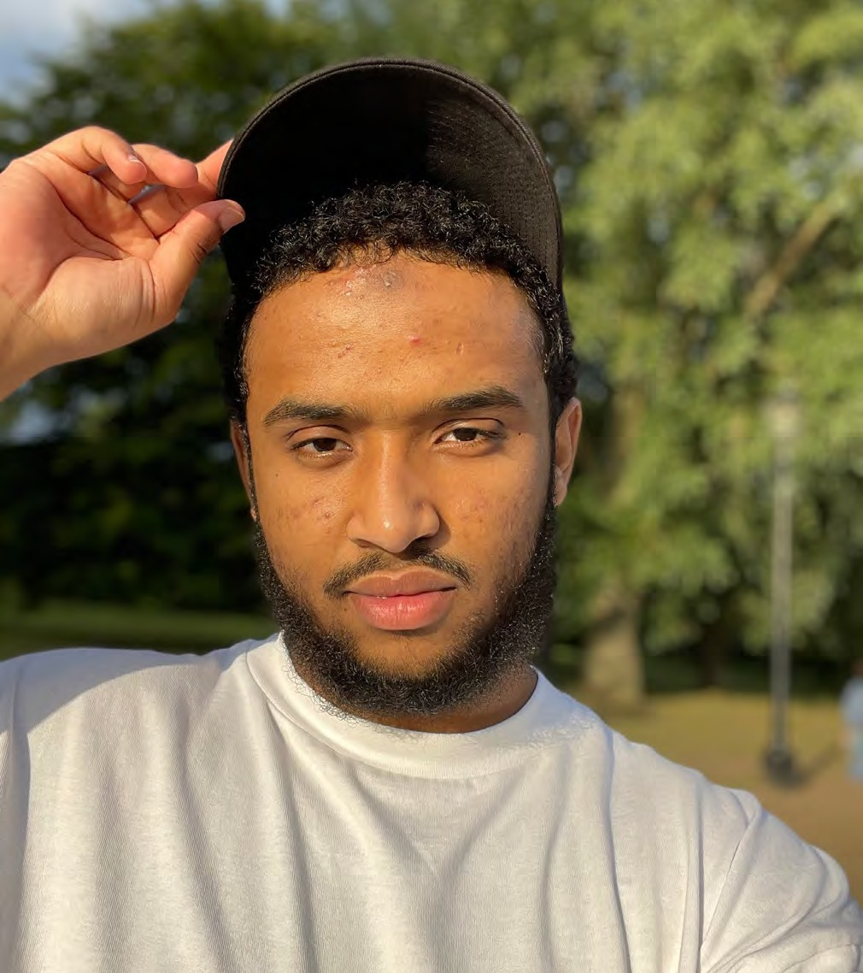
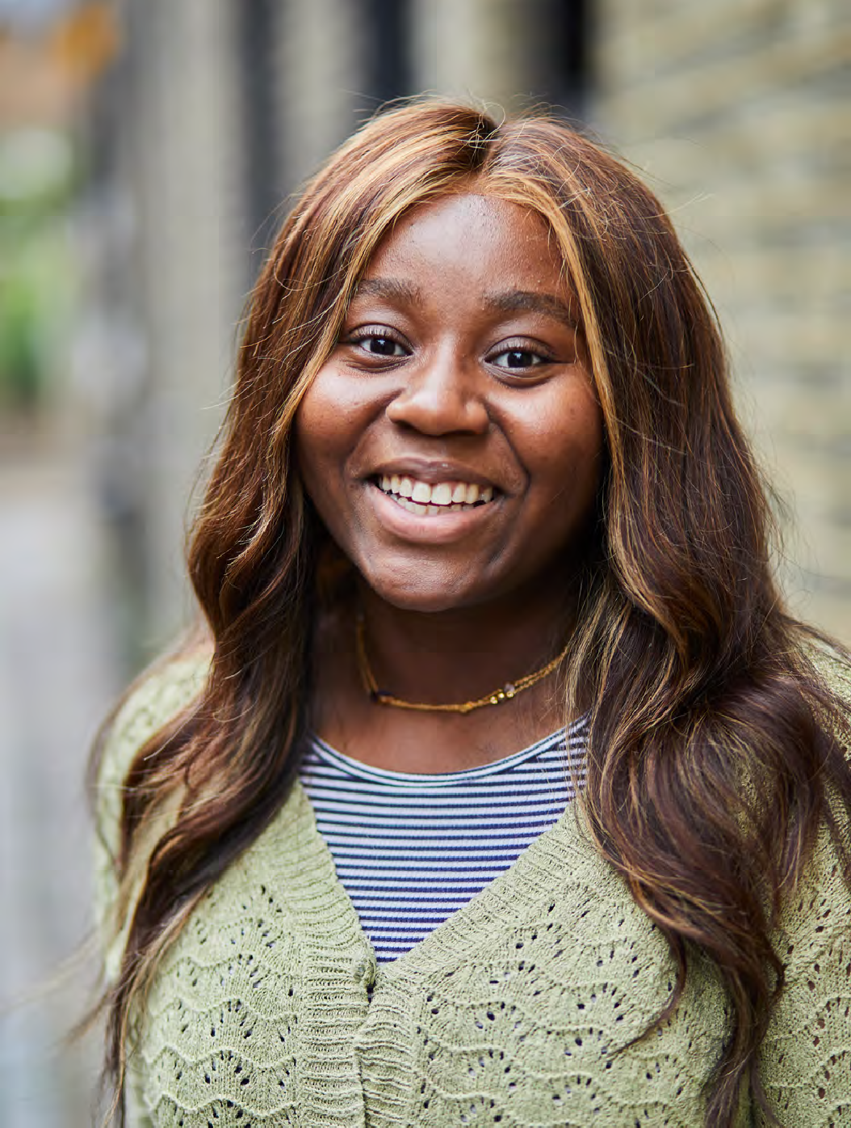
Who we’re here to serve
We are here to serve those communities of young people, who are both challenging and experiencing injustice in their individual lives and within society. This means young people who are the most disadvantaged as a result of poverty, social exclusion, discrimination or any other contributing factors. We do not seek to categorise young people or reduce their circumstances to eligible checklists, so this description does not attempt to be comprehensive. And we recognise and prioritise funding work that tackles the intersection of issues for example, racial justice and poverty.

Slide 5
We have highlighted 3 key groups of young changemakers.
Aspiring
Those with ideas, but very little to no experience of doing the actual work, who need the most amount of support in developing their ideas into action.
Emergent
Those who have some experience in doing work for social justice, but still need some support in developing ideas further, whether that be through resource or training, etc
Established
Those who have been doing this work for a while, who have had a lot of support and are mostly looking for financial resource to ensure they can sustain work that is already happening.
Challenge and Change is here to serve emergent young changemakers

Slide 6
Individuals
One person working to create social change.
Collectives
A group of people who are working together to achieve a common objective. This is usually organised a can be 2+ people.
Movements
A social movement is a loosely organised effort by a larger group of people to achieve a particular goal, typically one focused on social justice.

Slide 7
Eligibility
Who this fund is for | Who this fund is NOT for
18–25 year-olds in England Activating their lived experience to create social change. | Organisations not lead by young people hoping to launch work on behalf of young people.
Individuals, collectives and movements. | Work that could be funded by others – there are no other Lex funds so we need to limit the opportunity.
Those already doing some social justice work – this will look different for everyone. | Young people who have never been involved in social change work before.
Those who need resource to take their vision and plan to the next level. | Young people who are established in their social change work who could access our wider funding.
Those looking to make long term change on issues affecting young people’s lives. | One off pieces of work with no intention to create longer term change or continue the work further.
 | Young people wanting to set up a business, which has a social purpose component alongside it but is not its core focus.

Slide 8
Applications close on Thursday 12th May 5pm
Blagrave staff and YA’s will make final decisions in mid June.
All applicants will be informed by the end of June.
The welcome day for all successful applicants will be in London on Saturday 2nd July.
All funding will be agreed with terms and conditions at the end of July.
Process

Slide 9
Questions
challengeandchange@blagravetrust.org

